Slide 1
UNIT 7: WHAT DO YOU LIKE DOING ?
Teacher: Kiera

Slide 2
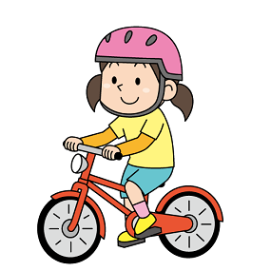
1. NEW WORDS
Riding a bike

Slide 3
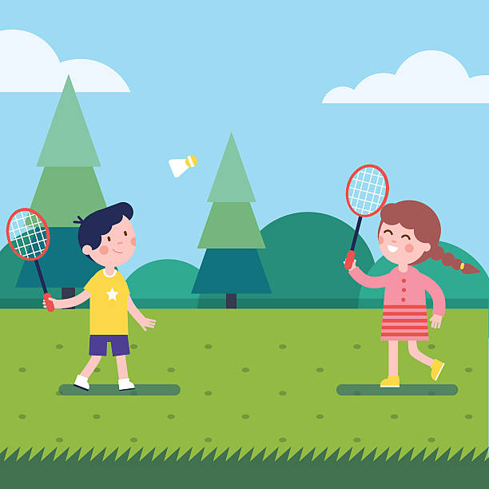
Playing badminton

Slide 4
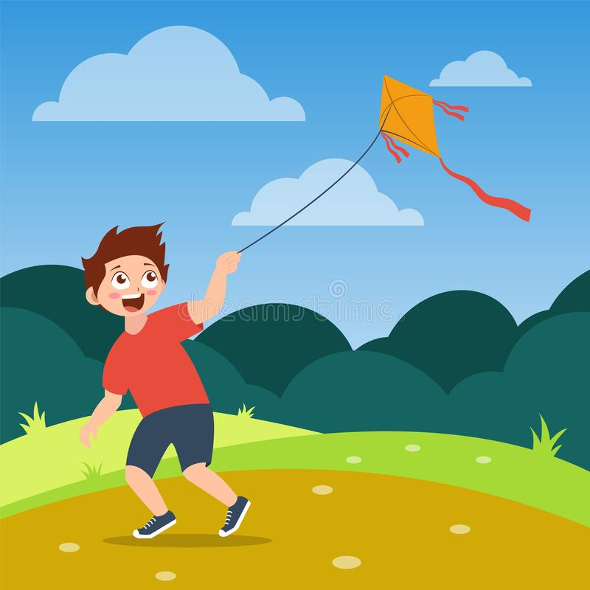
Flying a kite

Slide 5
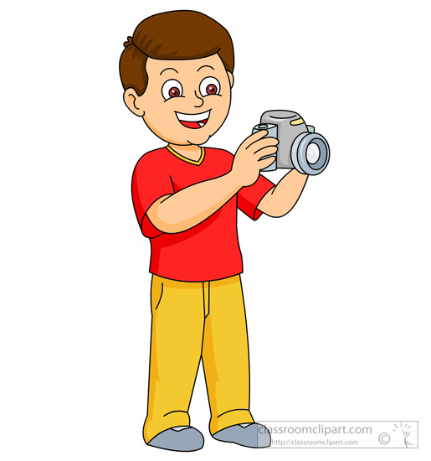
Taking a photo

Slide 6
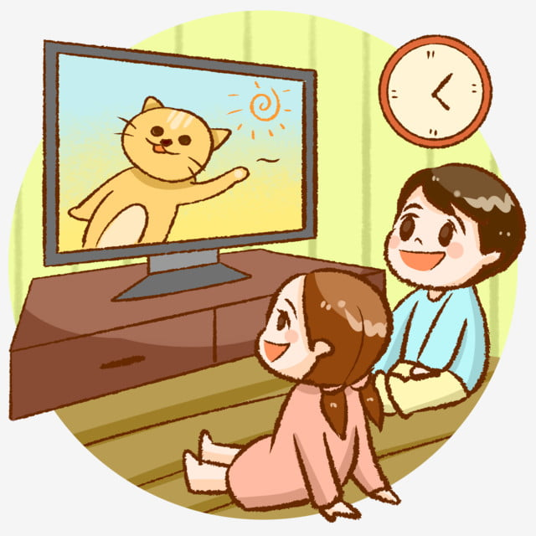
Watching TV

Slide 7
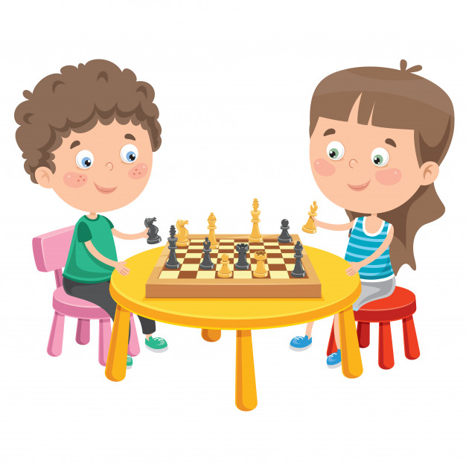
Playing chess

Slide 8
Listening to music

Slide 9
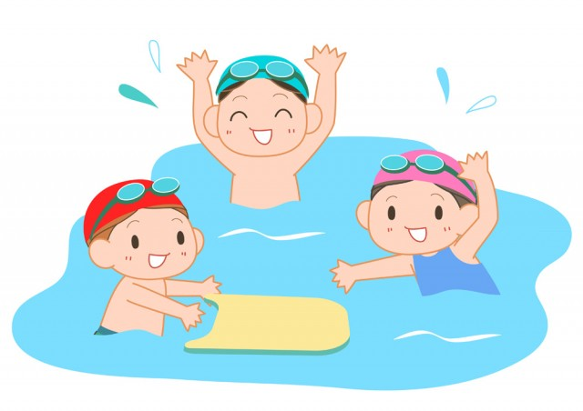
Swimming

Slide 10
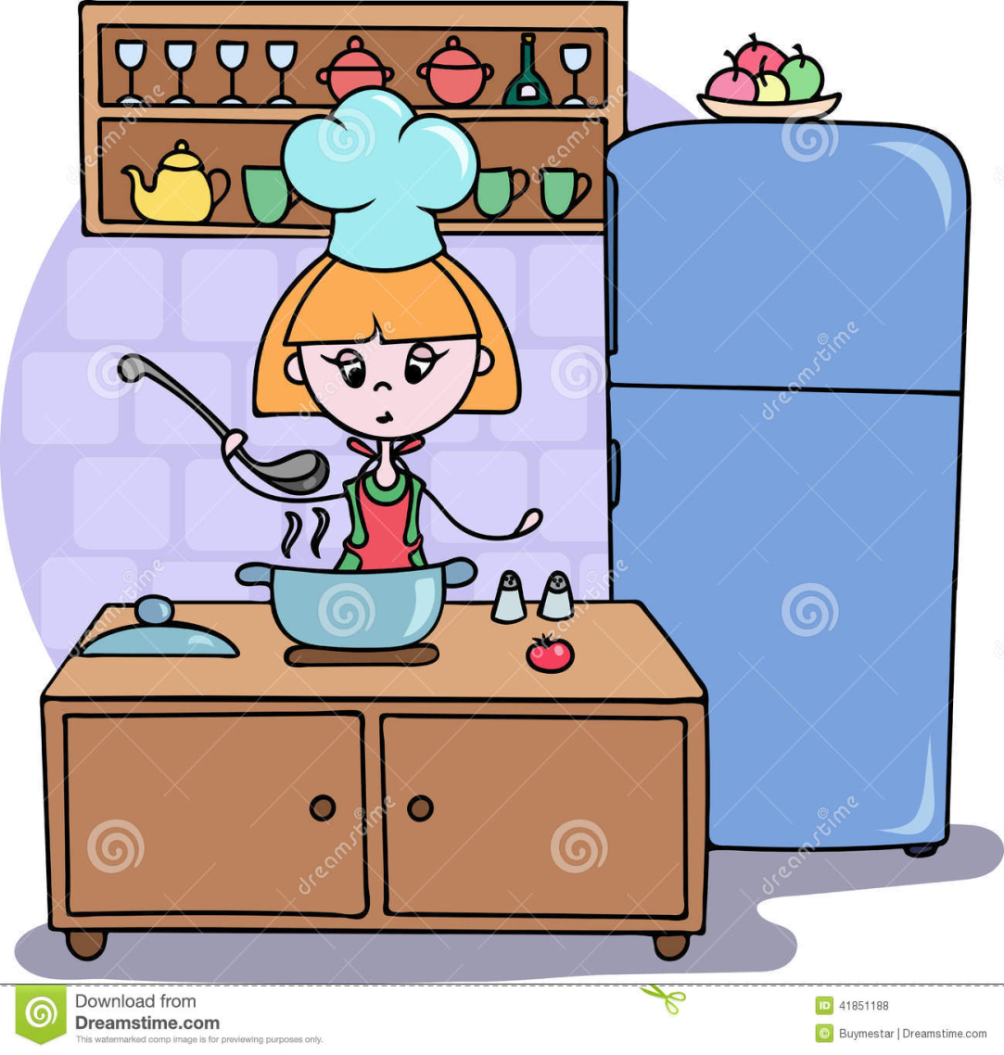
Cooking lunch/dinner

Slide 11
Reading a book

Slide 12
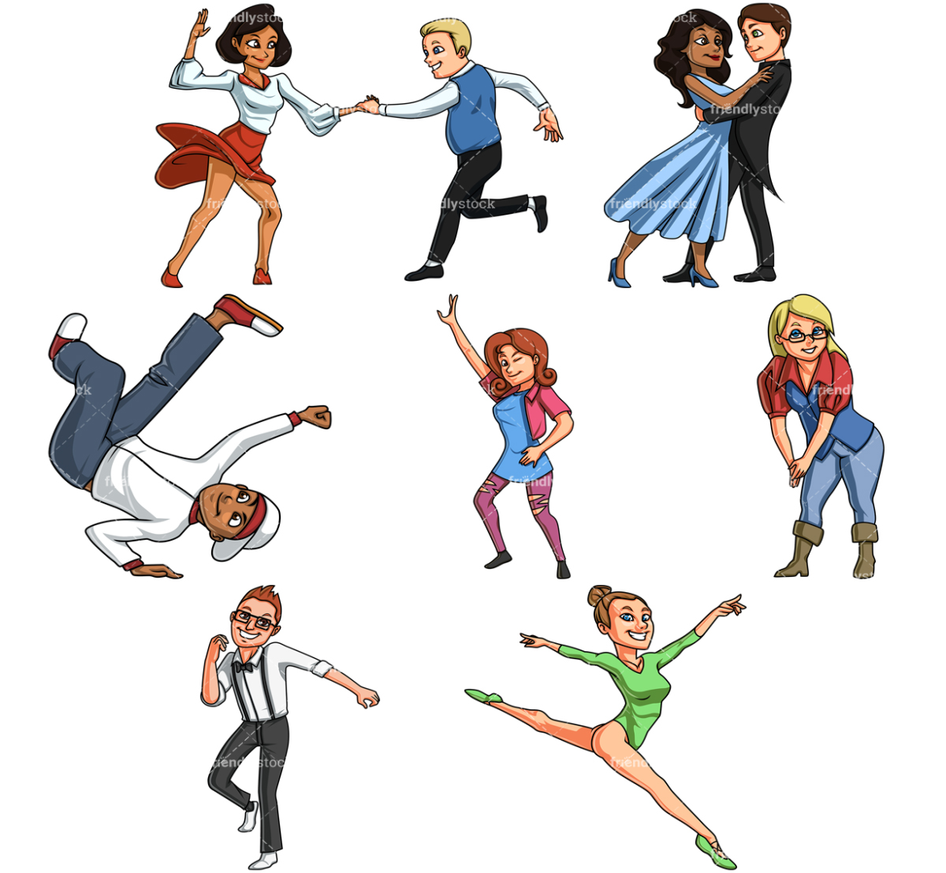
Dancing

Slide 13
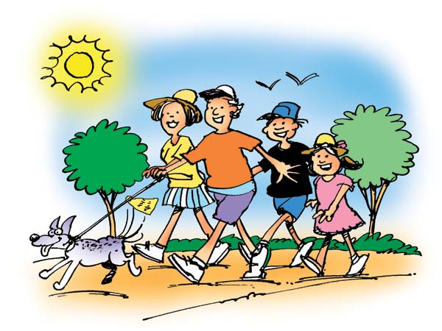
Going for a walk

Slide 14
2. REVIEW

Slide 16
3. MODAL SENTENCES
a. What’s your hobby?
- I like…..
- My hobby is …..
b. What do you do in your free time?
- I usually…..
c. What do you like doing
- I like ……

